Slide 1
WAEON election observation Field guide series
Introduction to the

Slide 2
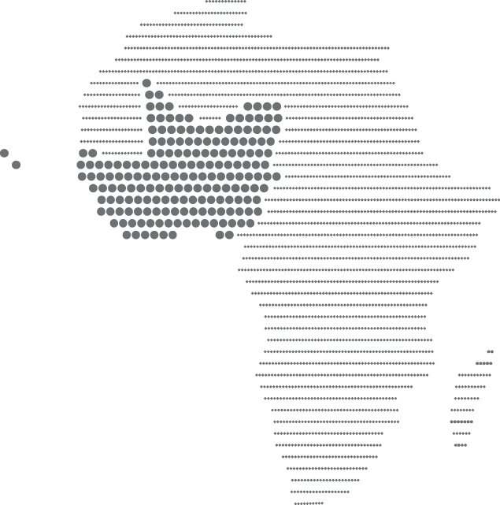
Origins of the Series
Various training academies inspired the network to develop a series of practical field guides as easy-to-use reference tools for citizen election observation groups in West Africa.
The goal of the guides are to serve as a technical resource for citizen observation groups as they perform ongoing election observation activity.

Slide 3






Three guides have been completed and are currently being printed.
Materials for Professional Election Observation: Designing Forms, Manuals and Trainings
Systematic Methods for Advancing Election Observation
Outreach and External Communication

Slide 4
Systematic Methods for Advancing Election Observation
Table of Contents
Introduction: What is Systematic Election Observation?
Organizational and Management Structure
Encouraging Diversity and Including Marginalized Populations
Recruiting and Deploying Observers
Data Collection
Data Management and Analysis
Quality Control
Presenting Observation Results

Slide 5
Outreach and External Communication
Table of Contents
I. Understanding Outreach & External Communication
Outreach and Communications Strategy
  Developing & Maintaining Contact List
  Understanding the Media
  Developing an Outreach/ External Communication Plan
  Developing media guidelines
  Outreach Monitoring & Evaluation
  Positioning your organization, be an expert source
Outreach tools
  Paper-based tools
    Information kits
    Media advisories
    Press/ News releases
    Pitch Letters
    Opinion editorials (op-ed)
  Face-to-face
    Presentation
    Phone call
    Briefings series
    Press conferences
    Interviews
  Technology based
    Mobile
    Website
    Blog
    Social Media
  Advantages and Disadvantages of Various Outreach Tools
Election statements and reports
Annex 1
Press Conference Checklist

Slide 6
Materials for Professional Election Observation: Designing Forms, Manuals and Trainings
Table of Contents
Understanding Observation Forms
Developing Observation Forms
Asking the Right Questions
Avoiding Common Mistakes
Election Day Checklists
Critical Incident Forms
Different Forms for Different Electoral Analysis
Developing Observer Manuals
Developing Supervisor Manuals
Designing Effective Training of Trainer (ToT) Seminars
Designing Effective Observer Trainings

Slide 7
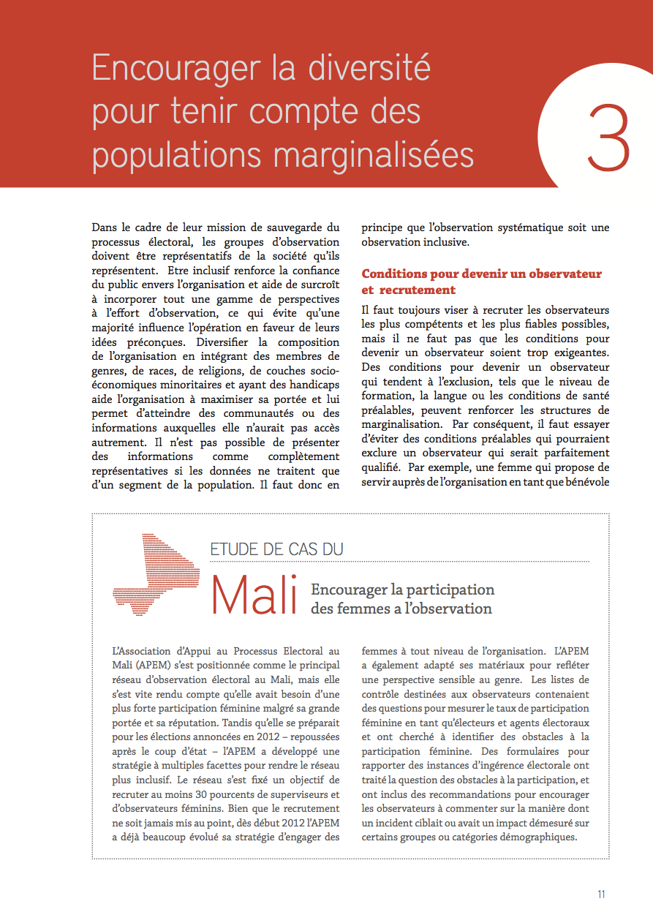

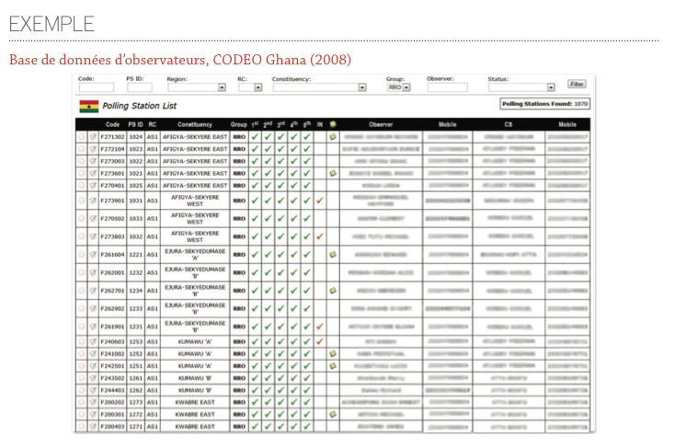
A Peek Inside
Actual examples of methods and best practices from WAEON members
Tips for organizing your efforts in the most effective way
Relevant chapter topics with topical case studies

Slide 8
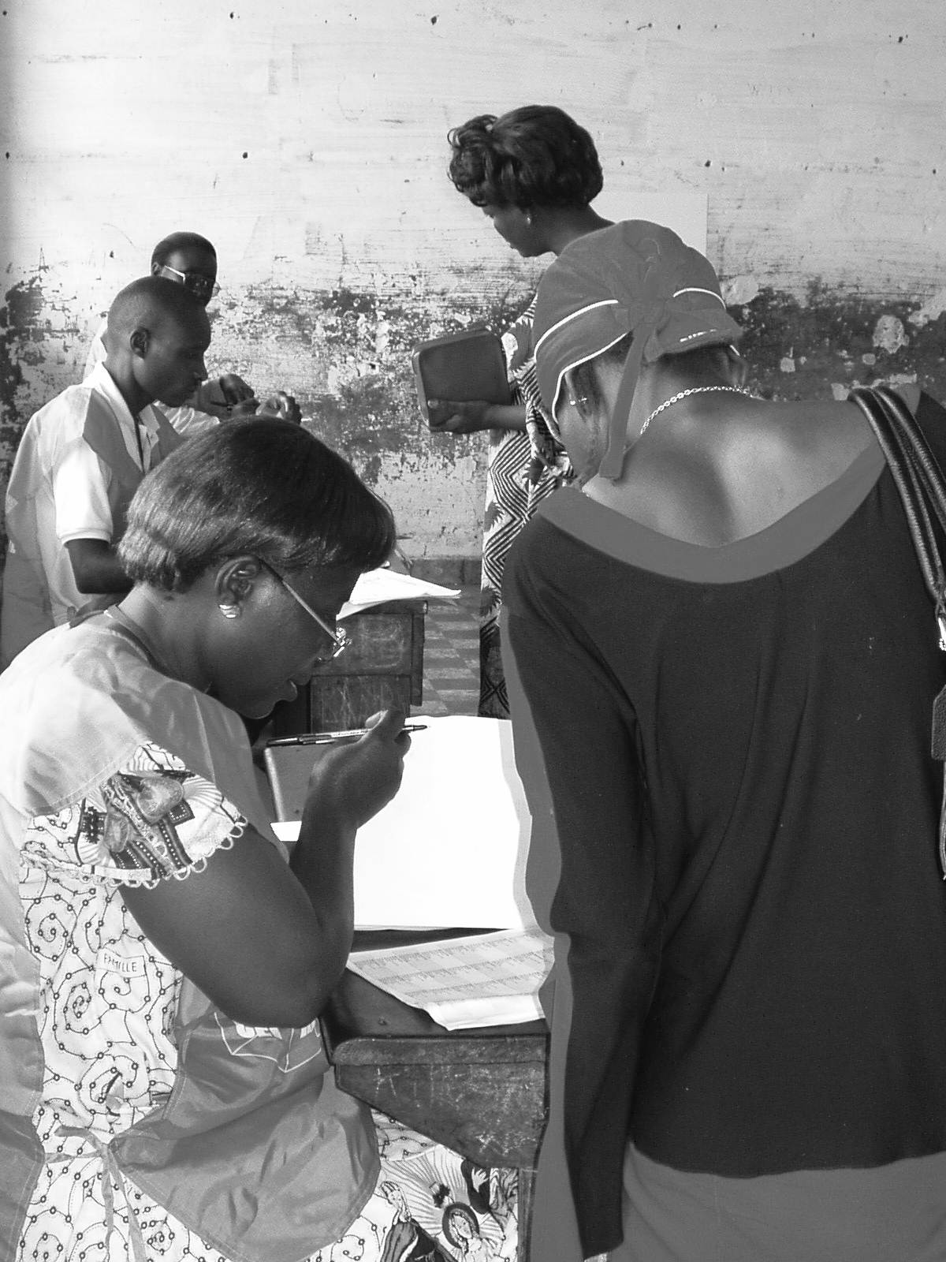
Final Versions of the Guides
NDI will be distributing the guides to your organizations soon.
Look through the interim copy of the Systematic Observation guide to see what is coming.
Finished versions should be arriving in the next few weeks.

