Slide 1
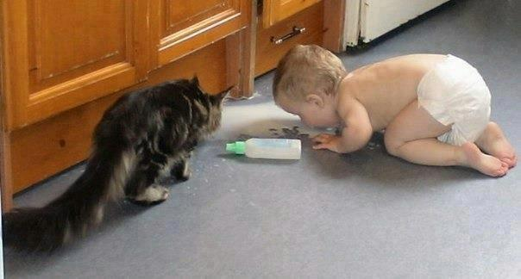
Blending distinctions and disjunctions
Advocacy for Democracy, Elections and Governance

Slide 2
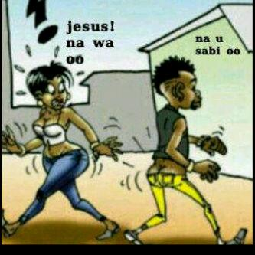
Distinctions

Slide 3
Distinctions
In mathematics, two thing are called distinct if they are not equal
In physics, two things are called distinct if they are not mapped to each other
It’s a state of being different or distinguishable

Slide 4
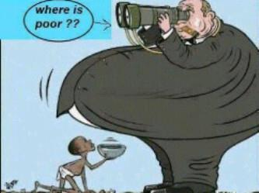
Disjunctions

Slide 5
Disjunctions
Simply put, a disjunction is a process of disconnecting or being disconnected

Slide 6
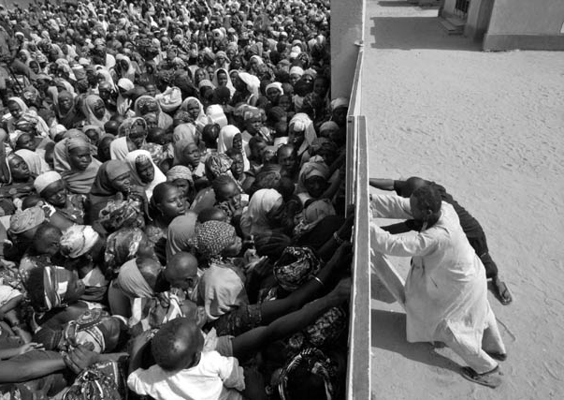

Slide 7
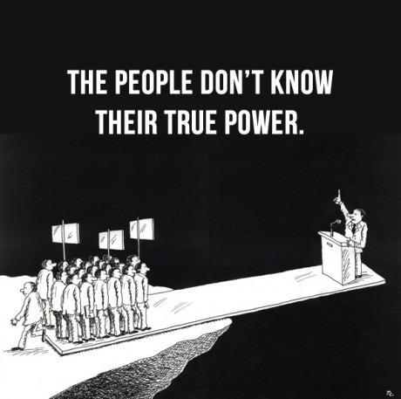

Slide 8

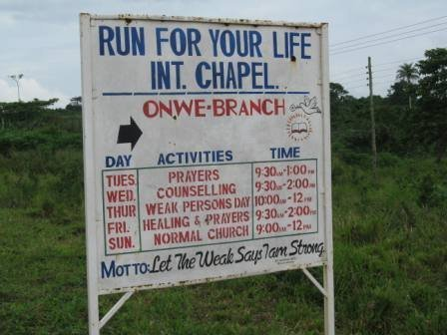
Things to Know
At the heart of advocacy is strategic communication

Slide 9
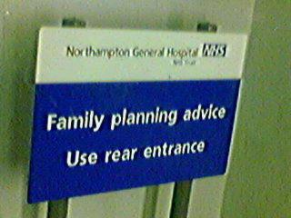

Things to Know
At the heart of advocacy is strategic communication

Slide 10
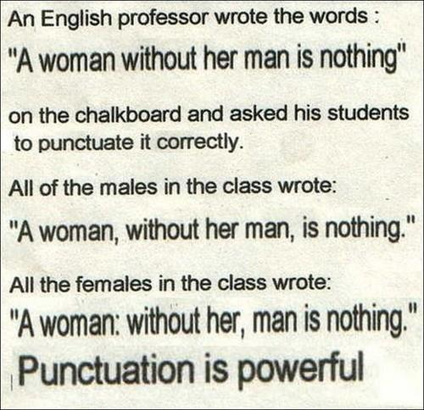
Things to Know
At the heart of advocacy is strategic communication

Slide 11
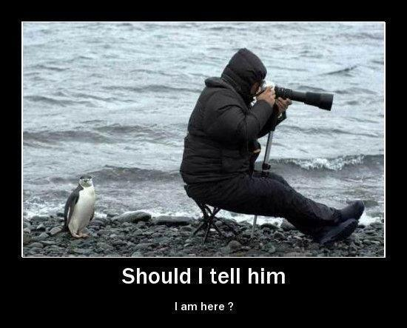
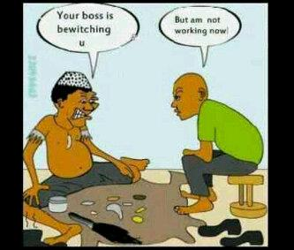
Things to Know
At the heart of advocacy is strategic communication

Slide 12
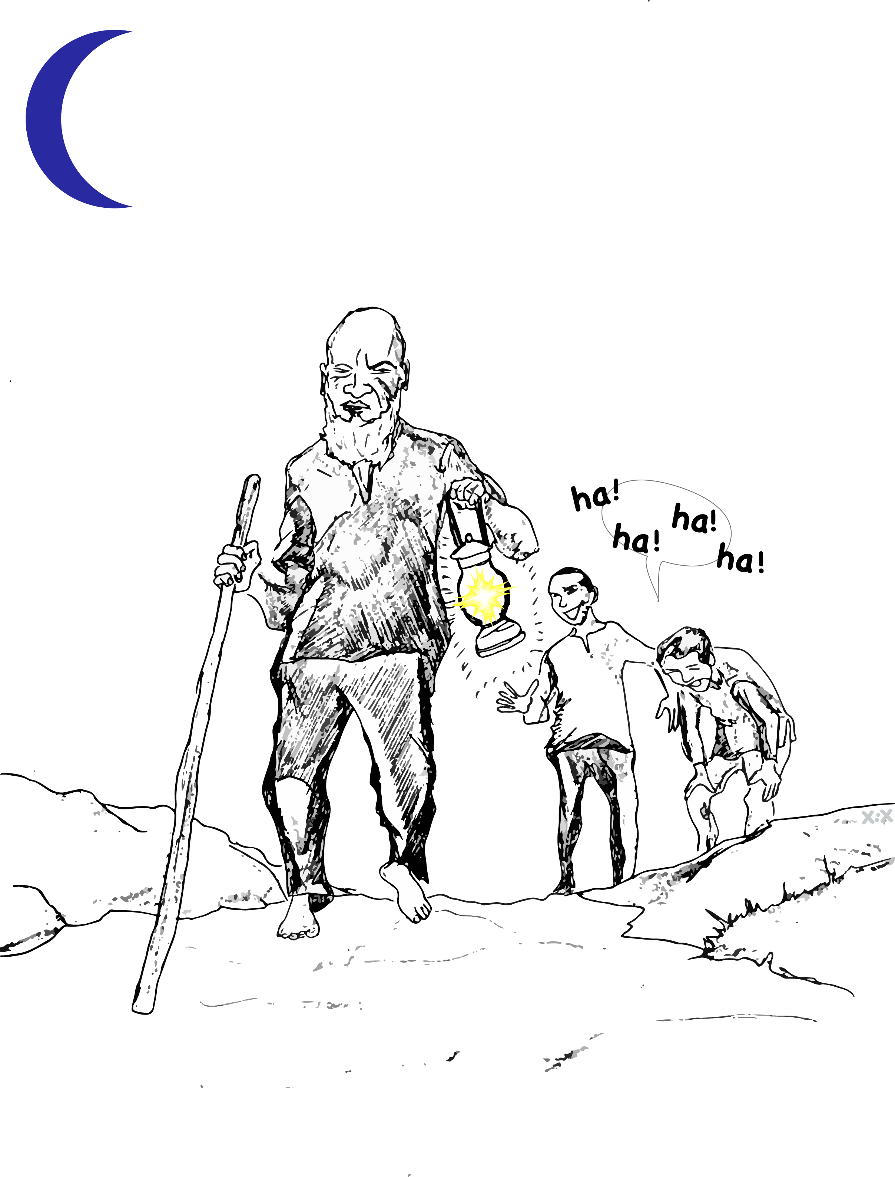
Things to Know
At the heart of advocacy is strategic communication

Slide 13
Things to Know: Understanding advocacy
What is advocacy?
What type of activities does advocacy involve?
Name three outcomes of effective advocacy?

Slide 14
Things to Know: Understanding advocacy
Advocacy consist of organized efforts and actions that use the instruments of democracy to establish and implement laws and policies that will create a just and equitable society. These instruments include elections, mass mobilization, civil action (including civil disobedience), lobbying, negotiations, bargaining and court action
David Cohen

Slide 15
Things to Know: Understanding advocacy
It may be conducted at local, national or international levels
It may be conducted at all three levels
You could be lobbying, mobilizing people at the grass root, leading strategic litigation, working with the media to raise awareness or build visibility or leading a protest or a demonstration

Slide 16
Things to Know: Understanding advocacy
Advocacy maybe Adversarial: expressing opposition, protest, and dissent or
It may be Negotiated: engaging with decision makers and building consensus and compromise or
It maybe Both

Slide 17
Things to Know: Scanning your advocacy environment
what are the factors or actors external to your organization, that has had an impact (negative or positive) on your previous efforts to advocate
What are the factors and actors internal to your organization that has had an impact (negative or positive) on your previous efforts to advocate

Slide 18
Things to Know: Scanning your advocacy environment
Develop the message- by clearly defining the issue, determine the outcome, determine the institutions and players capable of delivering the outcomes, package the message to suit different advocacy targets
Define the messenger- who will be the face of your message for each of your audience? A good but aggressive litigation lawyer conducting your case in court, may not be your best lobbyist working from within the national assembly just as an influential member of staff with government connections may not be a good choice for media liaison

Slide 19
Things to Know: Scanning your advocacy environment
Define the delivery- what platforms are talking for you with different members of your audience? Paying for the center spread of a major national daily for a message meant for farmers and artisans may amount to pouring water in basket
Often a good campaign will use multiple platforms

Slide 20
Things to Know: Scanning your advocacy environment
Sequence your steps- you might want to build a public profile for the issue via a focused media campaign as the first step to starting a powerful lobby in the national assembly
You want ask a question like; should we have the media cover our lobby visits? Would we get honest answers from our lobby targets when the tape is rolling?
Above all timelines should be carefully considered

Slide 21
Things to Know: Scanning your advocacy environment
Generally environmental scanning will allow you to mobilize your comparative advantage while you also understand your weaknesses.

Slide 22
Things to Know: power and influence analysis
Who has the power to make the changes you seek?
Who has the power to influence does who can make the change?
Who do you have the power to influence?

Slide 23
Things to Know: power and influence analysis
A power analysis gives you a strategic view of the field on which you are playing
Doing power analysis should be participatory- every member of your team should be involved
You must try to find out as much details as you can about those have the ability to affect the outcome of your campaign

Slide 24
Things to Know: power and influence analysis
You want to ask questions like; what is the name of the key actor (organization or individual ranked in order of priority), what drives or why is the key actor connected to the issue, who are the other actors that influence the key actor, who or what can the key actor influence, how will the key actor assert influence and what is the key actor changing her or his position

Slide 25
Things to do: The design
Who is qualified to do advocacy?
Are advocates born or made?
What steps have you taken so far in your attempt to advocate?
What principles have guided your previous attempts at advocacy?

Slide 26
Things to do: The design
Every advocacy attempt will;
Assemble a team and hold planning meeting
Identify and clearly state issues
Collect relevant information
Mobilize interested parties
Raise and manage needed resource
Build a network
Form alliances
Form and sustain coalitions
Involve the media

Slide 27
Things to do: The design
Establish contact with government, institutions and individuals
Have a monitoring mechanism
Must be measurable
Have a mechanism for re-planning and follow up

Slide 28
Things to do: The design
Advocacy will be guided by;
The belief that people have or should have certain basic rights
That these rights are enforceable through the practice of governance
Effort to correct institutional or societal failures
The principles of political action and activity
By the focused pursuit of a specific issue

Slide 29
Things to do: Lobbying
From your experience what is lobbying?
Did you apply any form of ethics in your previous attempt to lobby?
What advantages did you gain from lobbying?
How did you carry out lobbying?
What did you do in preparation for lobbying?
How did you ensure that your lobby was polite?

Slide 30
Things to do: Lobbying
Convincing those who have the power to make the change you desire
Organized attempt to be an individual, an organization, or both, wanting to influence on behalf of a particular interest, all relevant stakeholders that can make a system yield a desired change

Slide 31
Things to do: Lobbying
Trust and credibility are crucial ethical ingredients of lobby
Lying or presenting false witness destroys your lobby
Do not try to influence by bribing or corrupt means

Slide 32
Things to do: Lobbying
Efficient lobby will give you;
The advantage of defending the community’s expression
It helps you influence action and decisions of those in authority
It gives you relevance
It enables you to play role in making government accountable

Slide 33
Things to do: Lobbying
A lobby can be framed in;
A song, a slang, a symbol, a story, a skit, role play, position papers and memorandum, letters, phone calls, internet/website, formal meetings, informal meeting, special event, utilizing like minds as brand ambassadors, opinion and editorials and radio/TV interviews or talk show

Slide 34
Things to do: Using the legal system
Describe the basic functioning of the legal system as you encounter it from your experience?
Have you ever carried out any form of litigation?
How did you use the litigation as advocacy?

Slide 35
Things to do: Using the legal system
In a democracy;
The judiciary is the third arm of the state
It enforces the law, with respect to all individuals, companies and states
They also interpret and apply the law, through the courts
Courts are independent and subject only to the constitution
Courts are headed by judges that are supposed to be impartial and independent

Slide 36
Things to do: Using the legal system
Litigation is a challenge in court. In the case of advocacy network, such a case maybe against a minister, a government official or a department or policy

Slide 37
Things to do: Using the legal system
The courts can be used to advance advocacy campaign in several ways;
Status Quo Orders- that can temporarily halt an action or decision. Compelling the stopping of an action to gain some breathing space for a campaign
Amicus briefs: This is a way of intervening in a matter that the CSO is not directly a party to. For example, when the CSO go to court to challenge the provision or decision of government committee.

Slide 38
Things to do: Using the legal system
To interpret the Constitution- in terms of legislation which is passed. The judiciary can be used by an advocacy network in such instances to help pronounce such legislations unconstitutional
generally advocacy groups must be alert to opportunities to influence the courts when they play the role.
You want to carefully consider factors like the likelihood of fairness, the consequences of losing and the gains of a victory in court before choosing litigation as an option

Slide 39
Things to do: Community mobilization
Describe any form of community mobilization you have done before?
What advantages did you gain from community mobilization?
What disadvantages did you experience using community mobilization?

Slide 40
Things to do: Community mobilization
Community mobilization is key to changing societal attitudes and building the influence of an advocacy campaign. It educates the broadest possible number of people from a range of stakeholders

Slide 41
Things to do: Community mobilization
Community mobilization will;
Build popular support, social unity, develops a broad support base, encourages grass root education which strengthens the campaign, acts as a key instrument to increase the level of awareness amongst key decision makers and disadvantaged groups
It involves masses in decision making on issues that affect them
Promotes the emergence of volunteers for the campaign

Slide 42
Things to do: Community mobilization
Community mobilization could be challenging;
Because it requires extensive outreach capacity
A grass root education program must be factored along side the campaign- this maybe time and resource intensive
Demands an extensive management/coordination structure- CSOs could easily lose control of agenda
Diversity could potentially lead to greater politicization of the issue

Slide 43
Things to do: Community mobilization
Community mobilization may include;
Home visits to explain the campaign to key community players.
Community meeting to explain the campaign and buy community support
A comprehensive composition of the benefit of the campaign to the community
Poster, leaflets that explain the campaign and its benefits.
Drama skits that explain and communicate the need for the campaign to be taken round the community or shown at a community meeting.
Public screening of videos that can show the graphic need for supporting the campaign.
Testimonies or recounting of personal experiences during meetings

Slide 44
Things to do: Building alliances, networks and coalitions
Describe your previous work in alliances, networks and coalitions?
Did you find working in alliances, networks and coalitions important? Why?
What strategies did you use in building these relationships

Slide 45
Things to do: Building alliances, networks and coalitions
Alliances- functional relationship where participants co - ordinate their efforts and resources. The organizations may not always have common priorities overall, but as long as they have interest in the issue at hand, they are potential allies. The broader an alliance, the greater its impact on decision-makers or advocacy targets. The different allies increase the strength 0f the group as a whole and therefore increase their impact on the issue.

Slide 46
Things to do: Building alliances, networks and coalitions
Networks- loose form of collaboration, who share information, contacts and experience for social purpose
Networks always have intersecting interests and will usually aim at;
Strengthen the links,
Share the experiences,
Widen the information base,
Pool the expertise and
Understand the issue from all angles

Slide 47
Things to do: Building alliances, networks and coalitions
Coalitions- Groupings 0f organizations working together for a common concern. These organizations may belong to different sectors and they may ordinarily carry out different activities
It is a temporary agreement for combined action on the basis of a previously agreed position or goal

Slide 48
Things to do: Building alliances, networks and coalitions
No group, CBO / CSO can successfully achieve its advocacy goals without the help of other like-minded organizations.
Cooperating and co-coordinating with other stakeholders is essential in advocacy to broaden support and increase impact.
These relationships can take a number of different forms, some formal and others informal, some short-term and others longer-term, some principled and others pragmatic. Building such relationships is a complex and time consuming process.

Slide 49
Things to do: Building alliances, networks and coalitions
They provide strength in unity and numbers, and therefore facilitate greater impact;
They broaden the base of campaigns and thereby gain greater legitimacy with the with decision-makers; They enrich campaigns through the pooling of resources and the availability 0f a broader range services and skills;
They provide for sharing of information and experience;
They offer additional capacity for nation-wide monitoring; they help to build support and across sectors.
Providing a forum for the joint consideration of problems
Combining the financial, material and human resources of each member of the coalition

Slide 50
Things to do: Building alliances, networks and coalitions
Reducing competition for access to resources among or between coalition members
Being able to mobilize the interest of other people and groups
Being able to attract the attention of the media and people in influential positions
Providing greater support for members against harassment and repression

Slide 51
Things to do: Building alliances, networks and coalitions
Strategically you want to note that;
Conflict will occur no matter how well all participants’ intentions are.
Mixed loyalties are unavoidable. Coalition members owe their primary loyalty to their own organization.
Coalitions have to be accountable to their purpose and mission. They must sometimes take fast action but must do so without surprising their members.
Balancing unity and diversity is demanding. You can avoid problems by examining whether potentially troublesome matters will be addressed

Slide 52
Things to do: Building alliances, networks and coalitions
Additionally you want to always recognize and respect;
Goal differences among members
Ideological differences among members
Different expectations on results of actions or efforts among members
Power differences within the coalition
Differences of in levels of commitment to coalition objectives among members
Differences in financial and in-kind commitments among members
Differences in organizational style among different sized member groups.
Each group has 10 minutes to present their responses to items 1-3, after that synthesize their responses into one.

Slide 53
Things to do: Media and effective communication
Have you had reasons to work with the media before? What were the reasons?
Have you ever felt the need to communicate more effectively?
What specific advocacy work have you done with the media in the past?

Slide 54
Things to do: Media and effective communication
Generally, you can use the media to:
Increase the visibility of your organization (create “name recognition”)
Reach influential people in the society
Bring about reform in public institutions
Increase public awareness about certain issues
Bring about improved service delivery
Redress negative images or perceptions about your organization
Increase coverage of issues that your organization is concerned about.
Increase coverage of your organization’s events and activities.
Enhance the fundraising prospects of your organization

Slide 55
Things to do: Media and effective communication
To be effective, you must be knowledgeable about the issues you are campaigning on. Nothing can be more disastrous than an ignorant person trying to convince others about an issue which he or she knows little or nothing about or who cannot substantiate claims.
The quality of information you have and are able to present will play a crucial role in achieving your objective
In order to be effective in mobilizing a particular constituency, the information must be relevant to the lives of those people or the issues that concern them. If the information is not relevant to their issues, they are unlikely to be interested and cannot therefore be mobilized.

Slide 56
Things to do: Media and effective communication
In order to be effective in influencing and pressuring decision makers, information must be accurate – never lie. Once your information can be shown to be false, inaccurate or misleading, the credibility of your campaign will be seriously damaged.
In order to be effective in stimulating discussions, information must be up-to-date and based on or linked to current issues or events and not on issues that are moot.
In order to be effective in persuading people, the information must be convincing.
In order to be effective in provoking action and initiating change, information must be conclusive. The information should support the conclusion that you make from it.

Slide 57
Things to do: Media and effective communication
The media can be deployed to popularize the issue you are campaigning about to create public awareness around it and keep it constantly in the public domain so policy-makers and other government officials begin to feel that it is a matter of serious public interest which they must act on.
This makes it difficult for them to ignore your issue. Ways in which the media can be deployed for this purpose include the following

Slide 58
Things to do: Media and effective communication
Members of the advocacy team can organize visits to media managers, editors, editorial boards, etc. in different parts of the country to solicit media support
Ensure a constant stream of news on the issue you are campaigning about on radio, television, news magazines and newspapers so that it is constantly in the public domain.
Training journalists, particularly political correspondents and editors or other sector correspondents and editors as may be relevant for the issue to enable them engage effectively with politicians, policy-makers, legislators and public officials generally on the issue
Soliciting supporting editorial comments and endorsements about the issue by newspapers and news magazines. Radio and television stations can also air supporting news analysis and commentaries on the issue.

Slide 59
Things to do: Media and effective communication
Facilitating the publication of features and opinion articles about the issue in newspapers and magazines.
Facilitating discussion program and debates about the issue on radio and television stations
Production and airing of documentaries which highlight the issue on radio and television stations.
Production and airing of jingles on the issue on radio and television stations

Slide 60
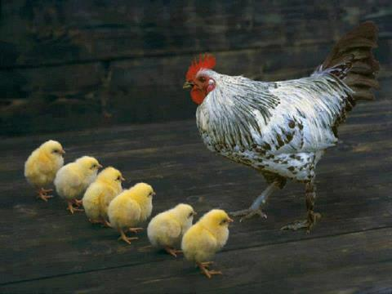
Time to plan and make it count

Slide 61
Thank you

